Slide 1
Data Visualization with Python
Session-Recap

Slide 2




Scope of the Course
Create figure, axes, subplots
Built on matplotlib and
can be used together with it
No need to import matplotlib or seaborn

Slide 3
Seaborn vs. Matplotlib
FEATURES | MATPLOTLIB | SEABORN
Functionality | It is utilized for making basic graphs. Datasets are visualised with graphs styles. Bar graphs, Histograms, Pie charts, Scatter plots, Lines and so on. | Seaborn contains a number of patterns and plots for data visualization. It uses fascinating themes. It helps in compiling whole data into a single plot.
Syntax | It uses comparatively complex and lengthy syntax. | It uses comparatively simple syntax which is easier to learn and understand.

Slide 4
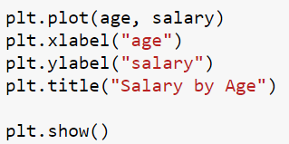
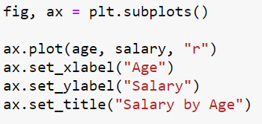
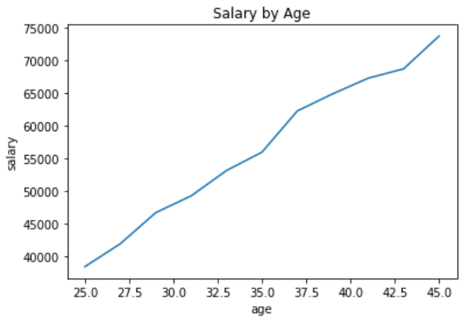
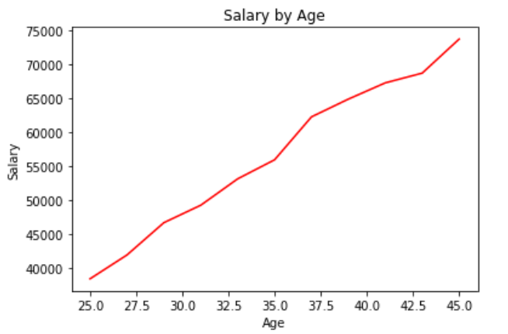
Two Methods
Functional
Object Oriented
Notes:
One famous instructor rather than multiple instructors. Do not use filled notebooks. Study on blank notebooks. Use filled notebooks only when studying projects.

Slide 5
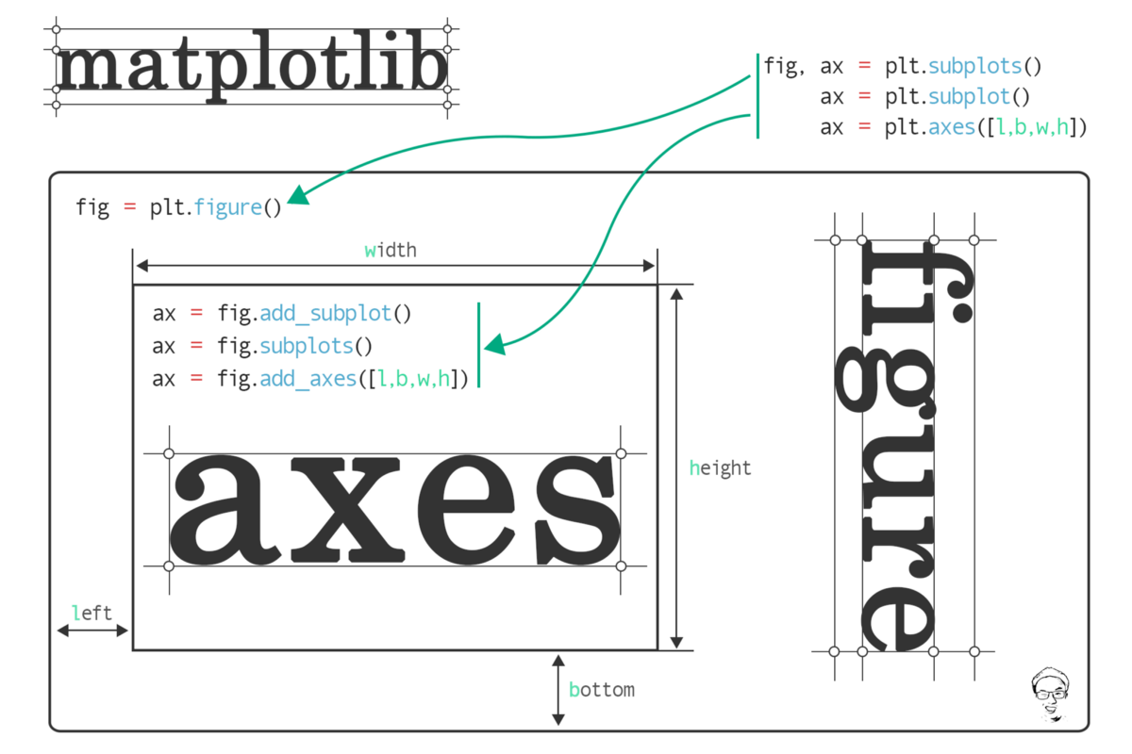
What do you think?
How do you describe
figure & axes?
Notes:
🍐 This is a Pear Deck Text Slide
🍐 To edit the type of question, go back to the "Ask Students a Question" in the Pear Deck sidebar.
One famous instructor rather than multiple instructors. Do not use filled notebooks. Study on blank notebooks. Use filled notebooks only when studying projects.

Slide 6
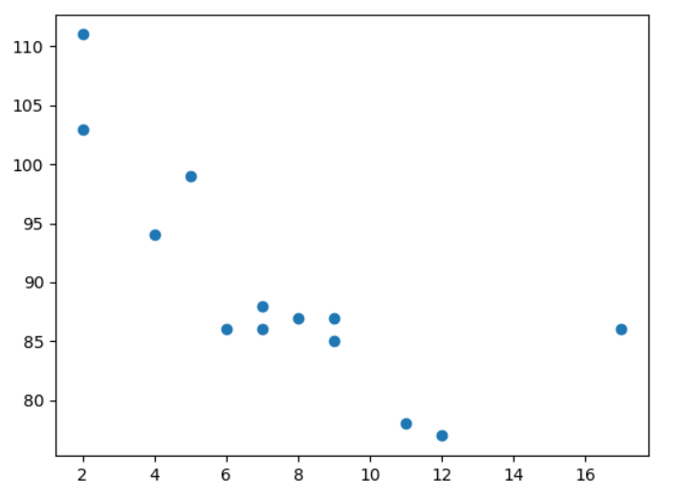

Scatter Plot
import matplotlib.pyplot as plt import numpy as np x= np.array([5,7,8,7,2,17,2,9,4,11,12,9,6]) y= np.array([99,86,87,88,111,86,
103,87,94,78,77,85,86]) plt.scatter(x, y) plt.show()
Notes:
One famous instructor rather than multiple instructors. Do not use filled notebooks. Study on blank notebooks. Use filled notebooks only when studying projects.

Slide 7
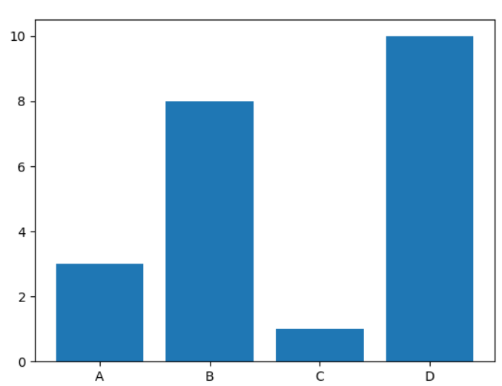
Bar Charts
import matplotlib.pyplot as plt import numpy as np x = np.array(["A", "B", "C", "D"]) y = np.array([3, 8, 1, 10]) plt.bar(x,y) plt.show()
Notes:
One famous instructor rather than multiple instructors. Do not use filled notebooks. Study on blank notebooks. Use filled notebooks only when studying projects.

Slide 8
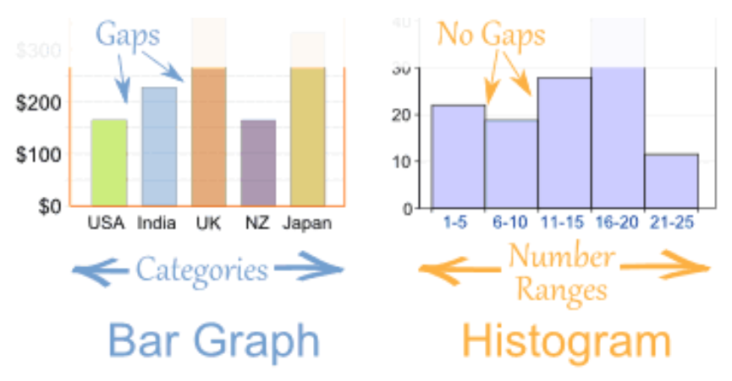
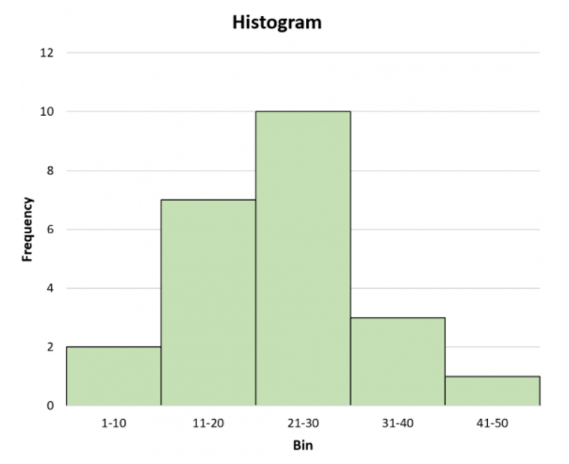
Histograms
Used with interval/ratio variables.
Represent the frequency of each attribute for a variable.
Good overview of the distribution of your data
Notes:
One famous instructor rather than multiple instructors. Do not use filled notebooks. Study on blank notebooks. Use filled notebooks only when studying projects.

Slide 9
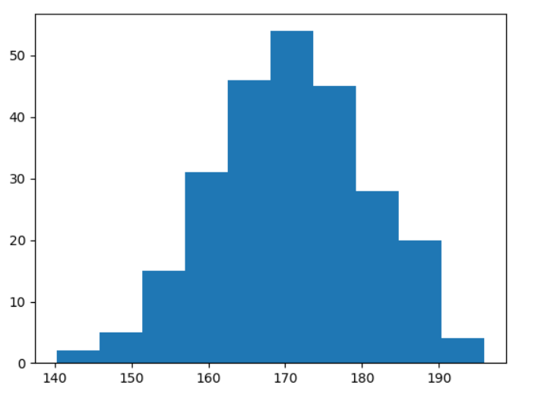
Histograms
import matplotlib.pyplot as plt import numpy as np x = np.random.normal(170, 10, 250) plt.hist(x) plt.show()
Notes:
One famous instructor rather than multiple instructors. Do not use filled notebooks. Study on blank notebooks. Use filled notebooks only when studying projects.

Slide 10
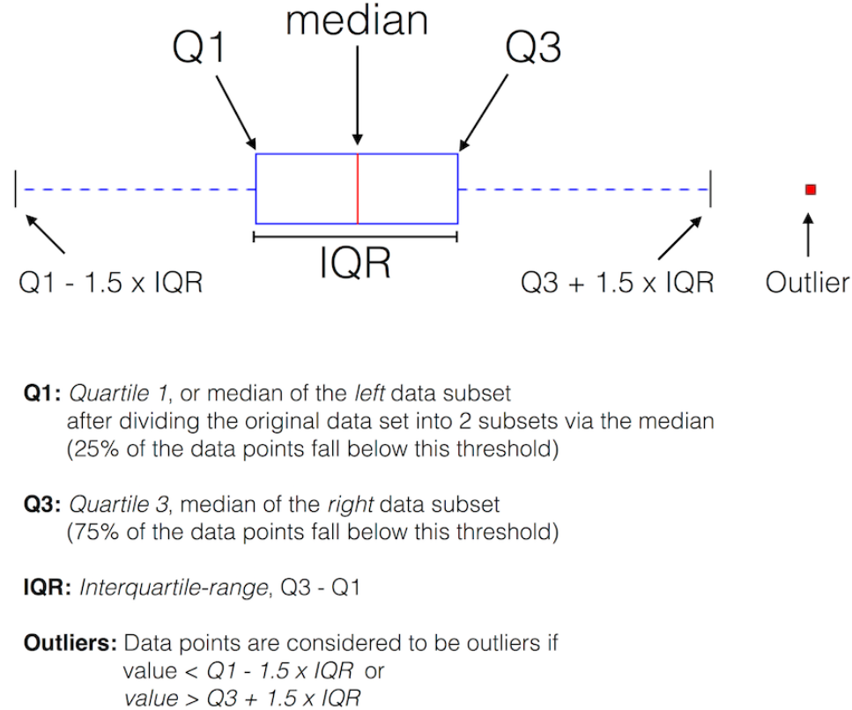
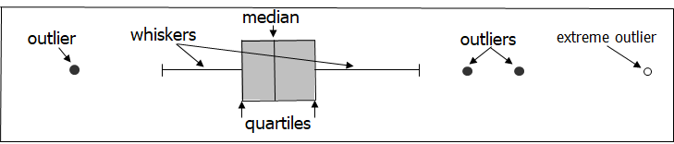
Box Plot
A box plot is a method for graphically depicting groups of numerical data through their quartiles.
A box plot generally shows median, 25th and 75th percentiles, and outliers.
Notes:
One famous instructor rather than multiple instructors. Do not use filled notebooks. Study on blank notebooks. Use filled notebooks only when studying projects.

Slide 11
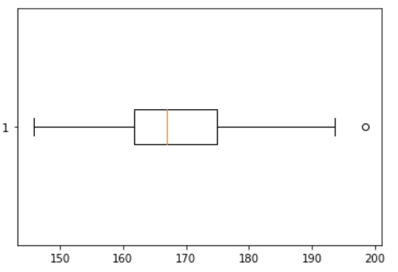
Box Plot
import matplotlib.pyplot as plt import numpy as np x = np.random.normal(170, 10, 250) plt.boxplot(x,) plt.show()
Notes:
One famous instructor rather than multiple instructors. Do not use filled notebooks. Study on blank notebooks. Use filled notebooks only when studying projects.

Slide 12
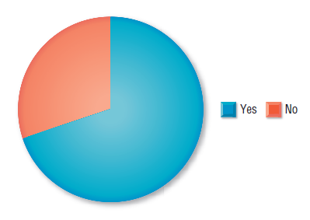
Pie Charts
Often used with nominal and ordinal variables.
Circle cut into “pie slices” that add up to 100%.
Each pie slice represents an attribute for the variable.
Notes:
One famous instructor rather than multiple instructors. Do not use filled notebooks. Study on blank notebooks. Use filled notebooks only when studying projects.

Slide 13
Seaborn Plot Types
Distributions Plots
Categorical Plots
Comparison Plots
kdeplot
rugplot
displot
histplot
barplot
countplot
boxplot
swarmplot
violinplot
jointplot
pairplot
catplot
matrix plot
grid plot
Notes:
One famous instructor rather than multiple instructors. Do not use filled notebooks. Study on blank notebooks. Use filled notebooks only when studying projects.

Slide 14
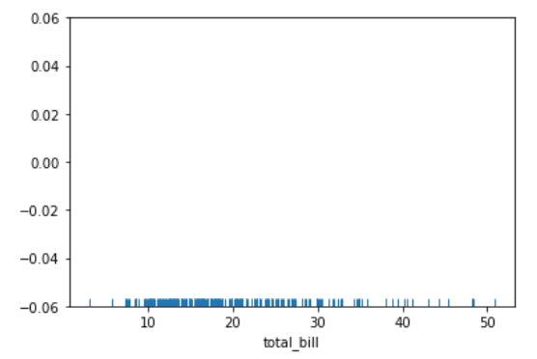
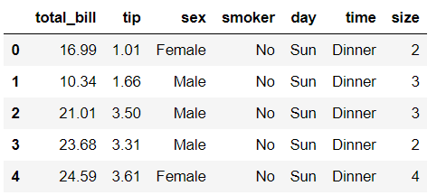
Distribution Plots - rugplot
import seaborn as sns
tips = sns.load_dataset("tips")
sns.rugplot(x='total_bill', data=tips)
sns.rugplot(tips['total_bill'])
Notes:
One famous instructor rather than multiple instructors. Do not use filled notebooks. Study on blank notebooks. Use filled notebooks only when studying projects.

Slide 15
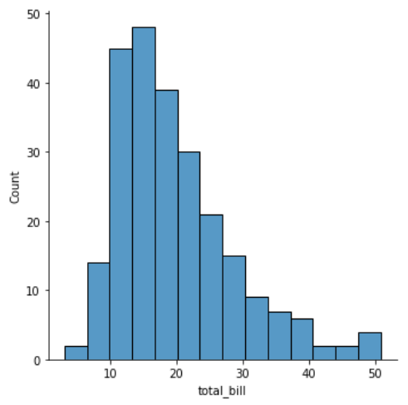
Distribution Plots - displot
import seaborn as sns
tips = sns.load_dataset("tips")
# Don’t use distplot
sns.displot(x='total_bill', data=tips)
sns.displot(tips['total_bill'])
Notes:
One famous instructor rather than multiple instructors. Do not use filled notebooks. Study on blank notebooks. Use filled notebooks only when studying projects.

Slide 16
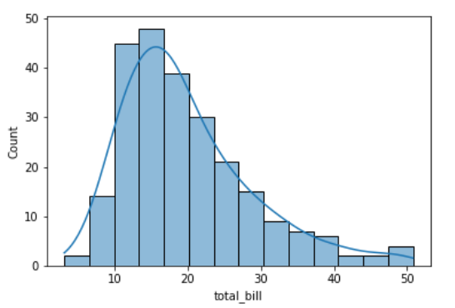
Distribution Plots - histplot
import seaborn as sns
tips = sns.load_dataset("tips")
sns.histplot(x='total_bill', data=tips, kde=True)
sns.histplot(tips['total_bill'])
Notes:
One famous instructor rather than multiple instructors. Do not use filled notebooks. Study on blank notebooks. Use filled notebooks only when studying projects.

Slide 17
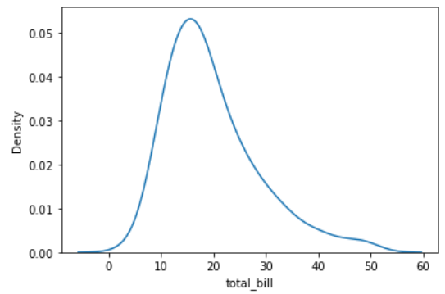
Distribution Plots - kde
import seaborn as sns
tips = sns.load_dataset("tips")
sns.kdeplot(x='total_bill', data=tips)
sns.kdetplot(tips['total_bill'])
Notes:
One famous instructor rather than multiple instructors. Do not use filled notebooks. Study on blank notebooks. Use filled notebooks only when studying projects.

Slide 18
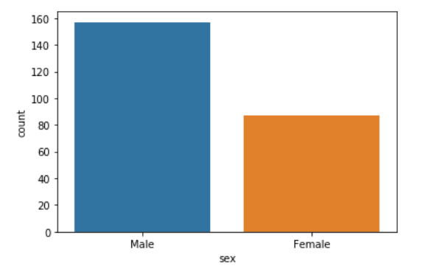
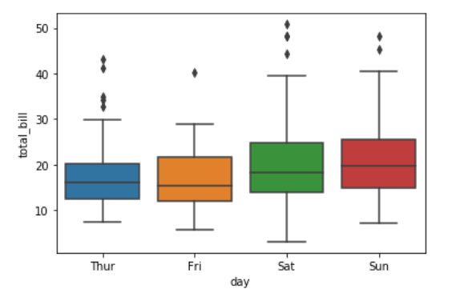
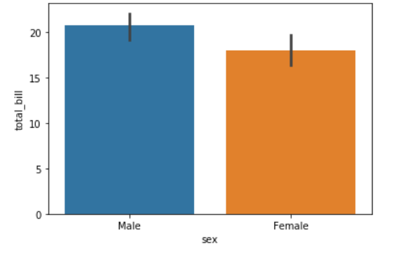
Categorical Plots
barplot
countplot
boxplot
Notes:
One famous instructor rather than multiple instructors. Do not use filled notebooks. Study on blank notebooks. Use filled notebooks only when studying projects.

Slide 19
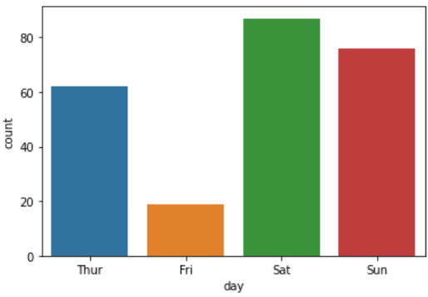
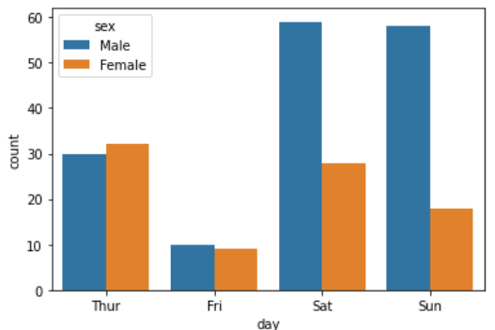
Categorical Plots - countplot
import seaborn as sns
tips = sns.load_dataset("tips")
sns.countplot(x='day',data=tips)
sns.countplot(tips['day'])
Notes:
One famous instructor rather than multiple instructors. Do not use filled notebooks. Study on blank notebooks. Use filled notebooks only when studying projects.

Slide 20
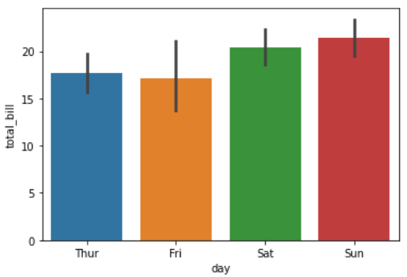
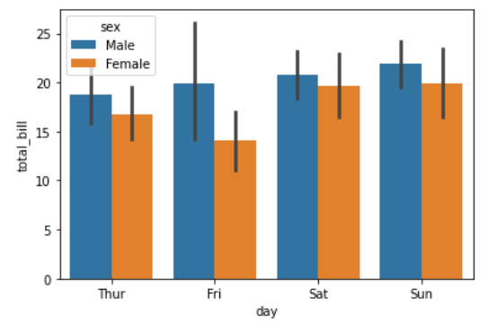
Categorical Plots - barplot
import seaborn as sns
tips = sns.load_dataset("tips")
sns.barplot(x='day', y="total_bill", data=tips)
sns.barplot(x='day', y="total_bill", data=tips, hue='sex')
Notes:
One famous instructor rather than multiple instructors. Do not use filled notebooks. Study on blank notebooks. Use filled notebooks only when studying projects.

Slide 21
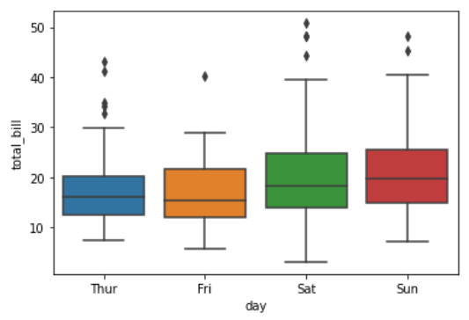
Categorical Plots - boxplot
import seaborn as sns
tips = sns.load_dataset("tips")
sns.boxplot(x='day', y="total_bill", data=tips)
Notes:
One famous instructor rather than multiple instructors. Do not use filled notebooks. Study on blank notebooks. Use filled notebooks only when studying projects.

Slide 22
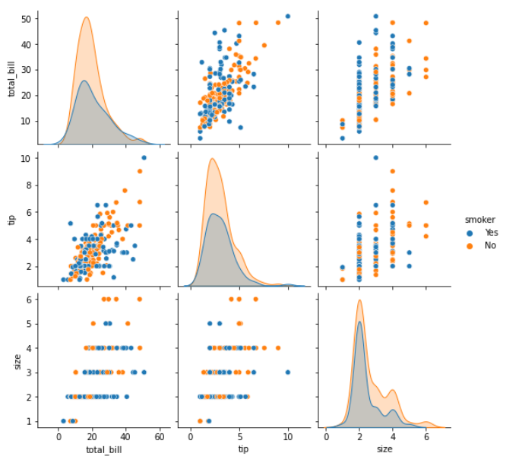
Comparison Plots - pairplot
import seaborn as sns
tips = sns.load_dataset("tips")
sns.pairplot(tips,hue="smoker")
# corner=True
Notes:
One famous instructor rather than multiple instructors. Do not use filled notebooks. Study on blank notebooks. Use filled notebooks only when studying projects.

Slide 23
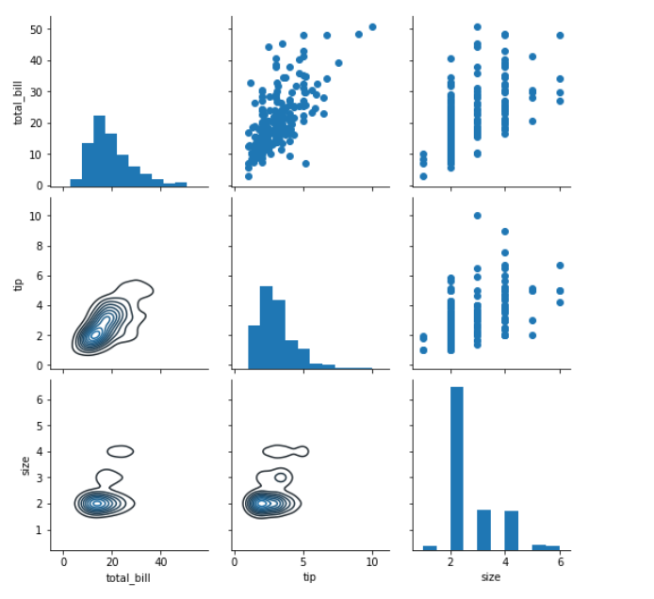
Grids
PairGrid
import seaborn as sns
tips = sns.load_dataset("tips")
g = sns.PairGrid(tips)
# g = g.map(sns.scatterplot)
g = g.map_upper(sns.scatterplot)
g = g.map_diag(sns.histplot)
g = g.map_lower(sns.kdeplot)
Notes:
One famous instructor rather than multiple instructors. Do not use filled notebooks. Study on blank notebooks. Use filled notebooks only when studying projects.

Slide 24
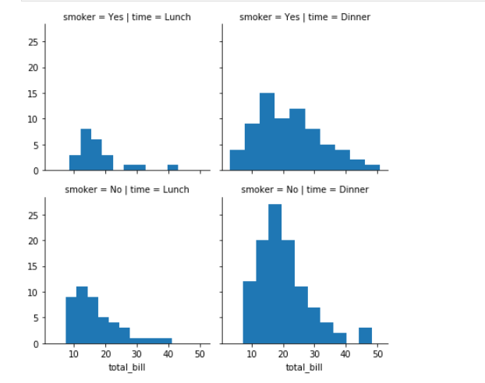
Grids
FacetGrid
import seaborn as sns
tips = sns.load_dataset("tips")
g=sns.FacetGrid( data = tips, col="time", row="smoker")
g=g.map(plt.hist,"total_bill")
Notes:
One famous instructor rather than multiple instructors. Do not use filled notebooks. Study on blank notebooks. Use filled notebooks only when studying projects.

Slide 25
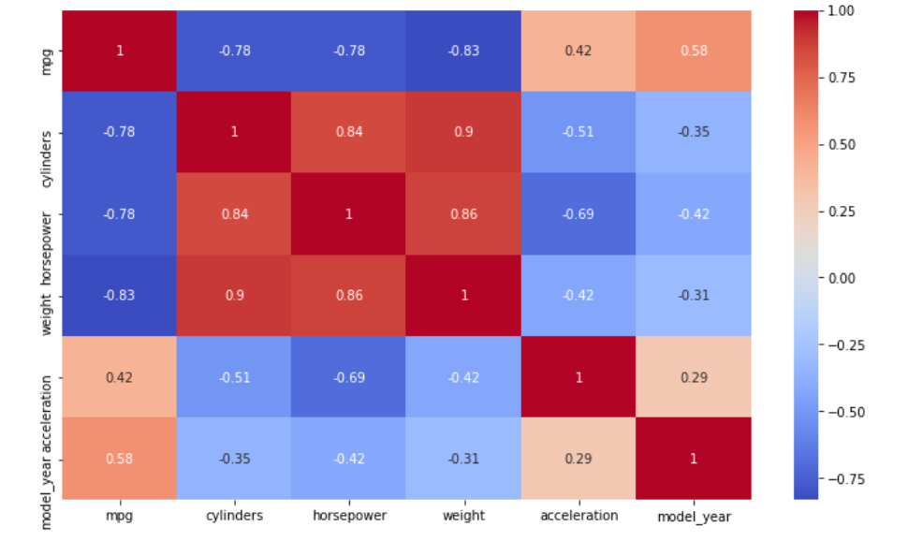
Matrix Plots
heatmap
import seaborn as sns
sns.heatmap( df.corr() )
Notes:
One famous instructor rather than multiple instructors. Do not use filled notebooks. Study on blank notebooks. Use filled notebooks only when studying projects.

